Slide 1
Vision Transformer (ViT) for Colon Patch Classification
Bryan wong
2021.11.12

Slide 2
ViT Brief Overview
Back then, the challenge of using transformers on images was that they contain a lot more data (pixels)
Vision Transformers were first introduced in the paper AN IMAGE IS WORTH 16X16 WORDS: TRANSFORMERS FOR IMAGE RECOGNITION AT SCALE by the Google Brain team in late October 2020.
The paper demonstrates that CNNs are not required for image classification tasks, and that a pure transformer applied directly to sequences of image patches can perform very well.
When pre-trained on large amounts of data and transferred to multiple mid-sized (ImageNet, CIFAR-100, VTAB, etc.), Vision Transformer (ViT) attains excellent results and requiring substantially fewer computational resources to train.
CNN : local attention over pixels
ViT: global attention over image patches

Slide 3
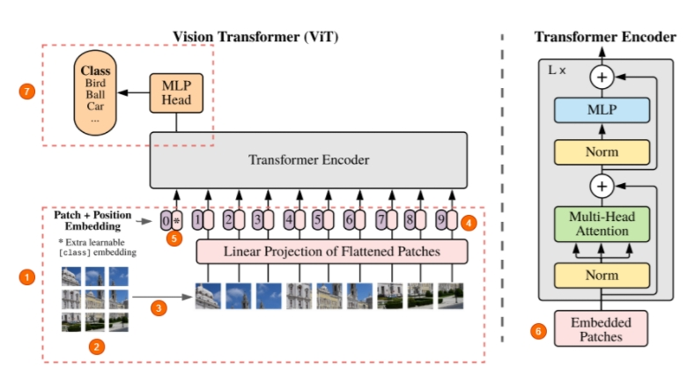
ViT Model Architecture

Slide 4
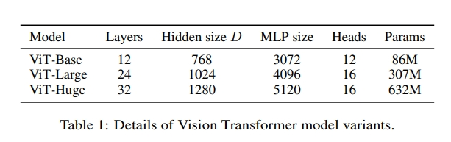
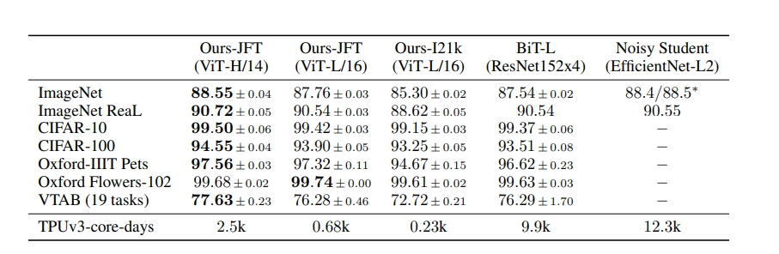
Details & Comparison

Slide 5
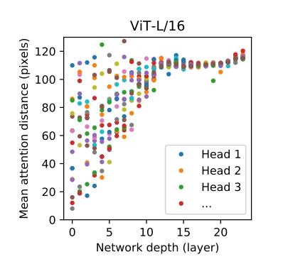
Transformers over CNN

Slide 6
Dataset and Model
3000 images(75% training, 25% validation):1000 Dysplasia, 1000 Malignant, 1000 Normal
Image augmentations: Resize((IMG_SIZE, IMG_SIZE)), Random Horizontal Flip(p=0.3), RandomVerticalFlip(p=0.3), RandomResizedCrop(IMG_SIZE), Normalize to Imagenet mean and std
Model:
ViT-Base/patch’s patch size:16, pre-trained on imagenet21k and fine-tuned on imagenet2012
ViT-Base/patch’s patch size:32, pre-trained on imagenet21k and fine-tuned on imagenet2012
ViT-Base/patch’s patch size:16, pre-trained on ImageNet-21k and then fine-tuned on ImageNet at 224x224 resolution (instead of default 384x384)

Slide 7
Hyperparameters
Batch size: 8
Optimizer: SGD – learning rate:2e-05 and momentum:0.9
Epochs: 50 | Early Stopping – Patience 3 epochs

Slide 8
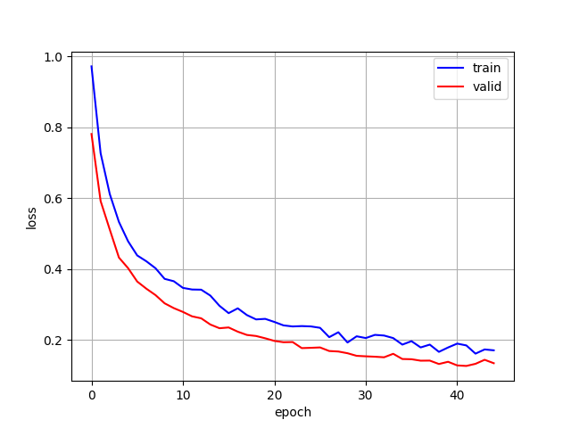
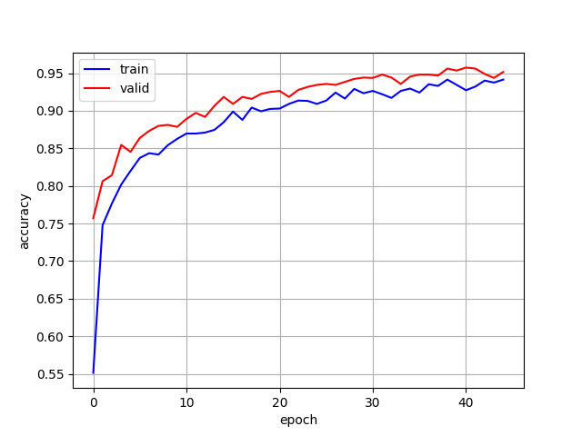
VIT-Base (patch’s patch size:16), Pre-trained on Imagenet21k and Fine-tuned on Imagenet2012
Tested on another 3000 images (1000 Dysplasia, 1000 Malignant, 1000 Normal):
Correct: 2753 out of 3000 images (Accuracy: 91.77%)

Slide 9
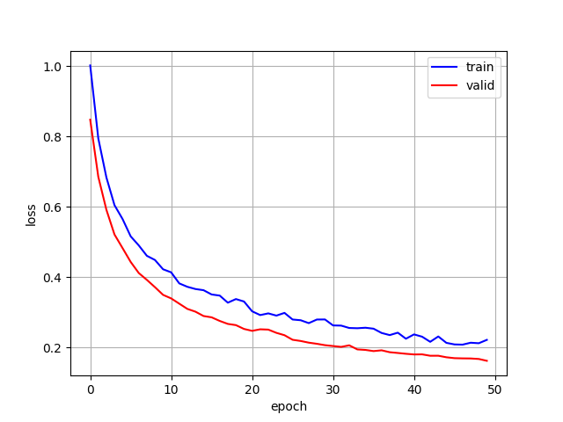
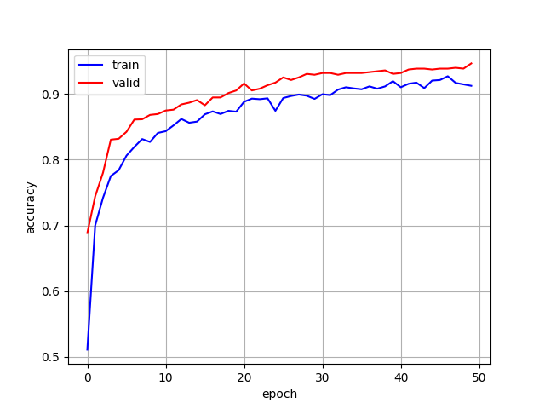
VIT-Base (patch’s patch size:32), Pre-trained on Imagenet21k and Fine-tuned on Imagenet2012
Tested on another 3000 images (1000 Dysplasia, 1000 Malignant, 1000 Normal):
Correct: 2716 out of 3000 images (Accuracy: 90.53%)

Slide 10
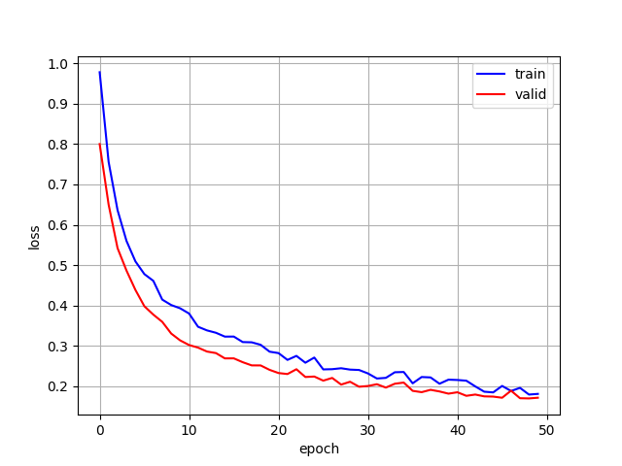
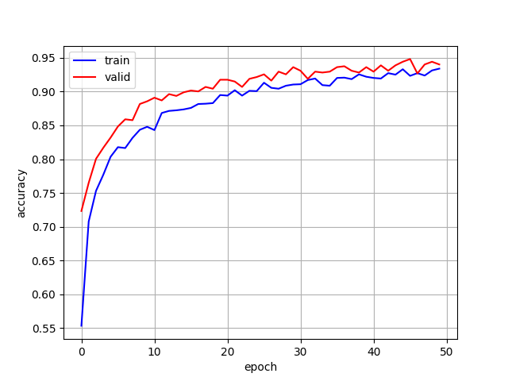
VIT-Base (patch’s patch size:16), Pre-trained on Imagenet21k and Fine-tuned on Imagenet2012 at 224x224 resolution (instead of default 384x384)
Tested on another 3000 images (1000 Dysplasia, 1000 Malignant, 1000 Normal):
Correct: 2715 out of 3000 images (Accuracy: 90.5%)

Slide 11


